Slide 1
Enhance security & reduce road violence

Slide 2
1. Blacklist
2. QCAM-App
3. Section Control

Slide 3
Blacklist

Slide 4
Blacklist
Blacklists
Whitelists
Scheduler
Cameras
Configuration of Blacklist plans
Generation of hits
Processing available for policemen

Slide 5
Blacklist
Detection possible without license plate recognition based on Make – Model – Colour – Type : For example look for all « White Volvo Van»
Add a whitelist to your plan
Add a scheduler to your plan
Choose your cameras
Priorities Sum-Up
Configure your HIT-Screen : Police – Colour – Fields to show – …

Slide 6
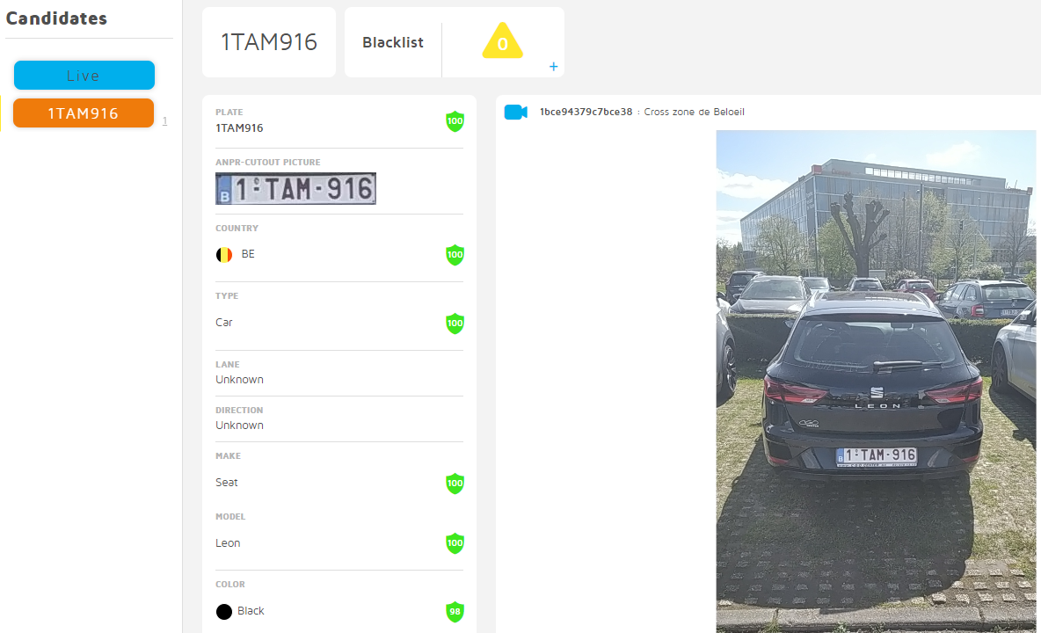
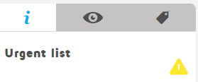
Blacklist
Back office for storage + control

Slide 7
Blacklist
Keypoints
Real time process : < 3 sec
MMR/Colour information available
You can configure a search based on MMR/Colour information
Notification : sound + mail
Geo-localised on a map
Comments possible
Possible retention (history)
Conclusion
Must have application to make all police-activities easier
All together for a safer place

Slide 8
QCAM-App

Slide 9
Why QCAM-App?
Converts a smartphone into an ANPR camera with two different mode : photo mode & video mode.
Method:
QCAM-APP uses embedded Machine Learning models for detection and recognition and can work with no Internet connection.

Slide 10
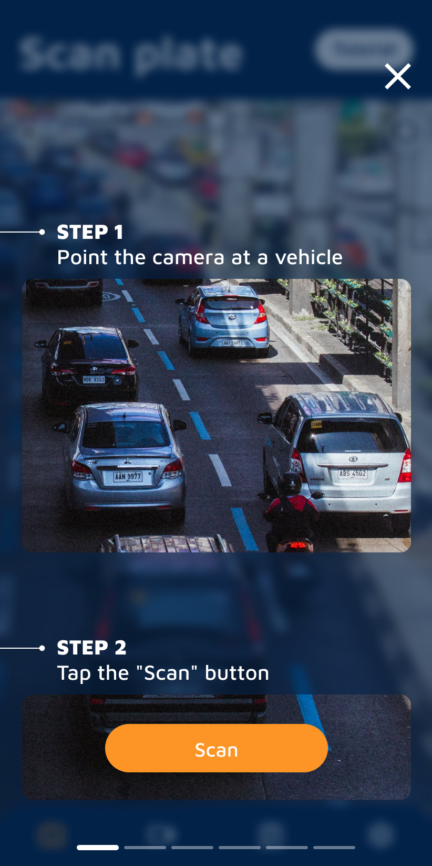
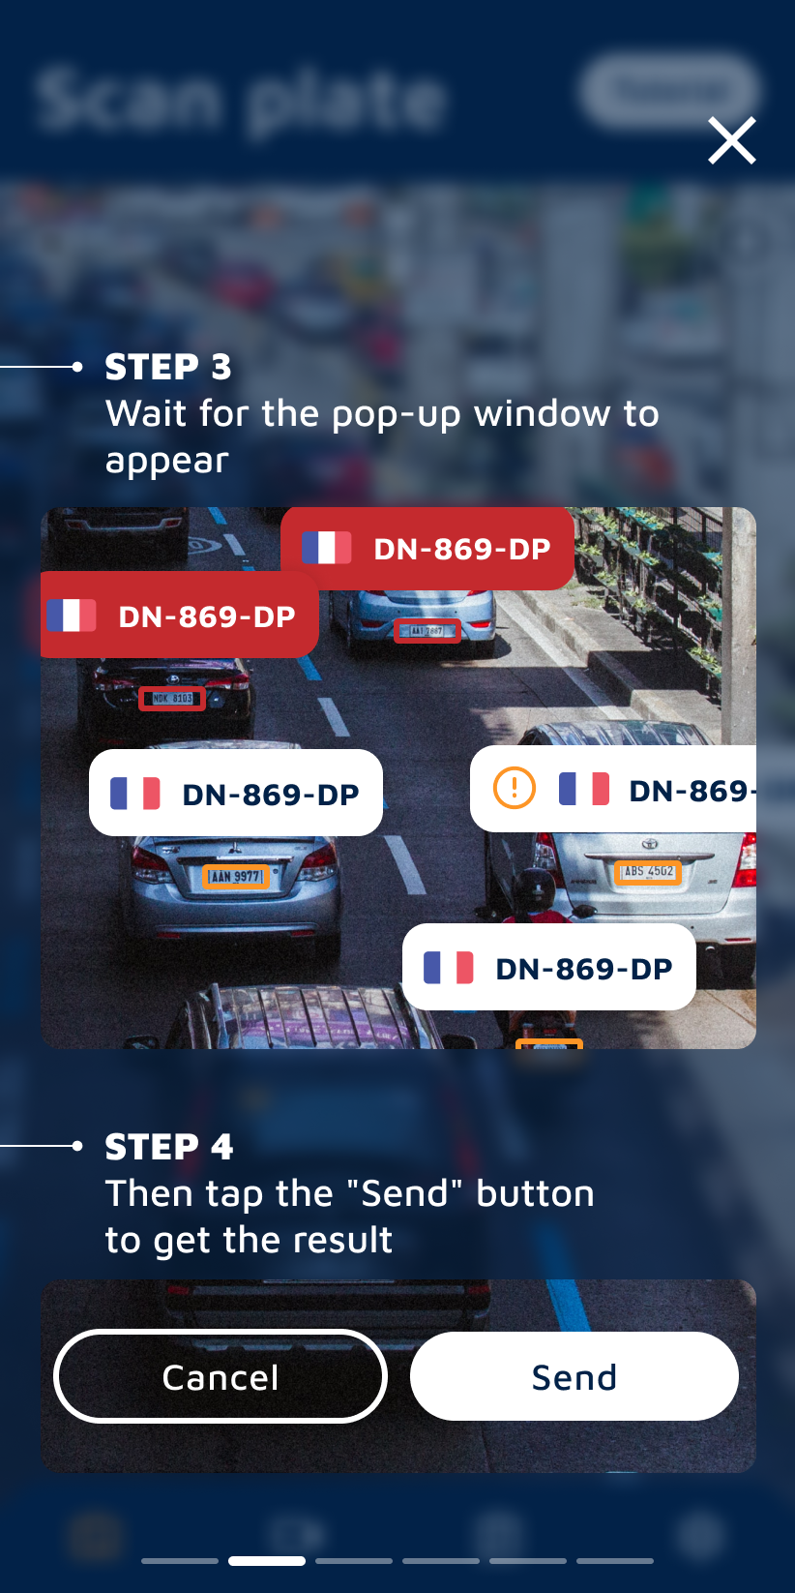
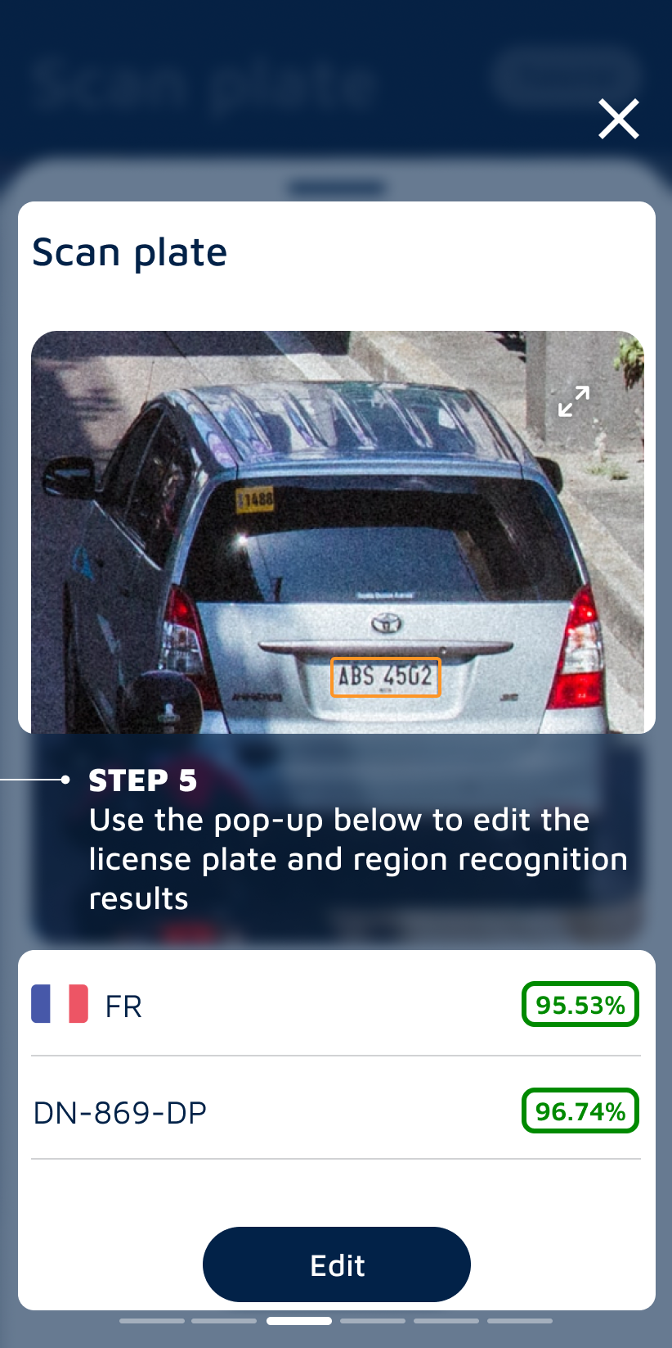
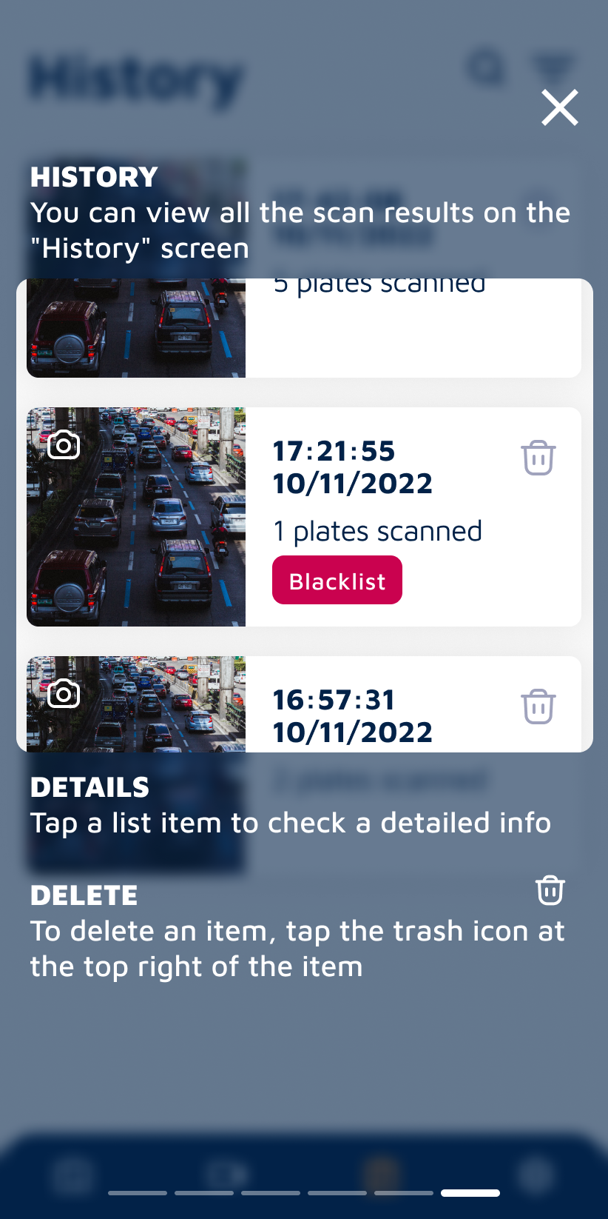
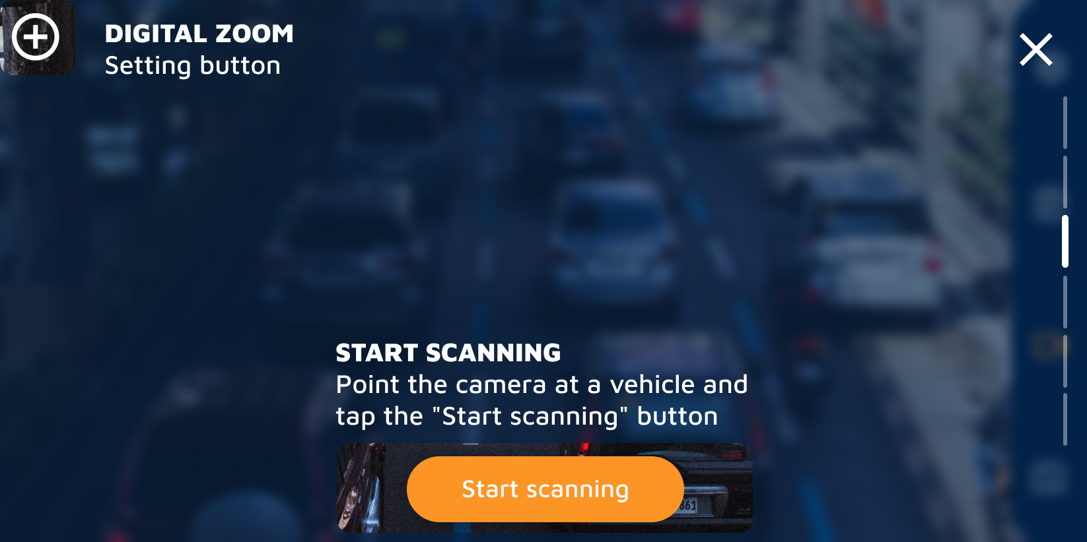
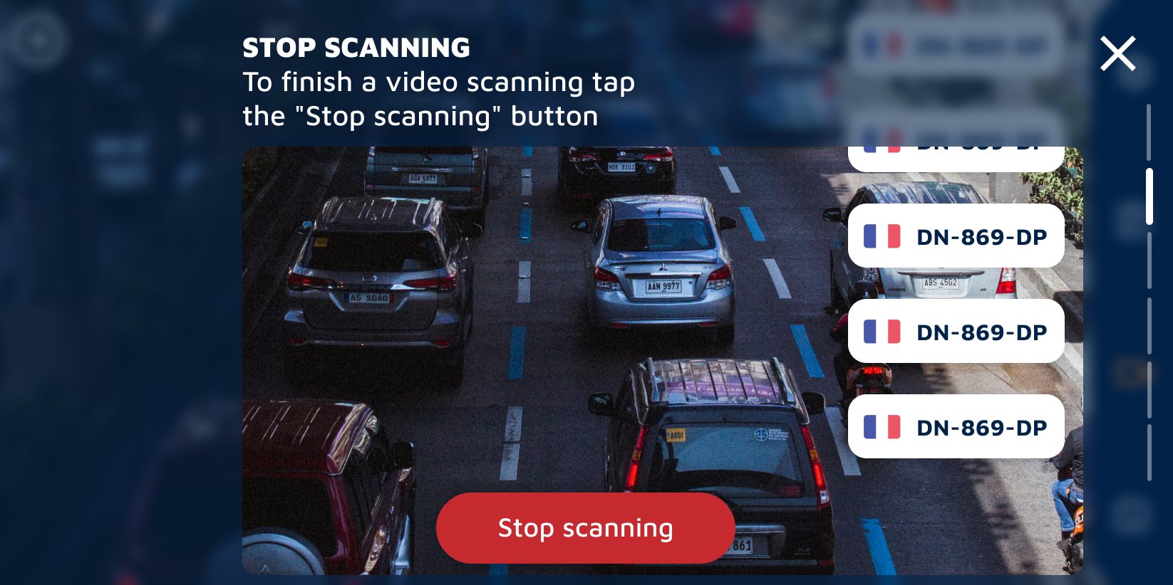
QCAM-App
Tutorial screen
The video tutorial is also available in the app

Slide 11
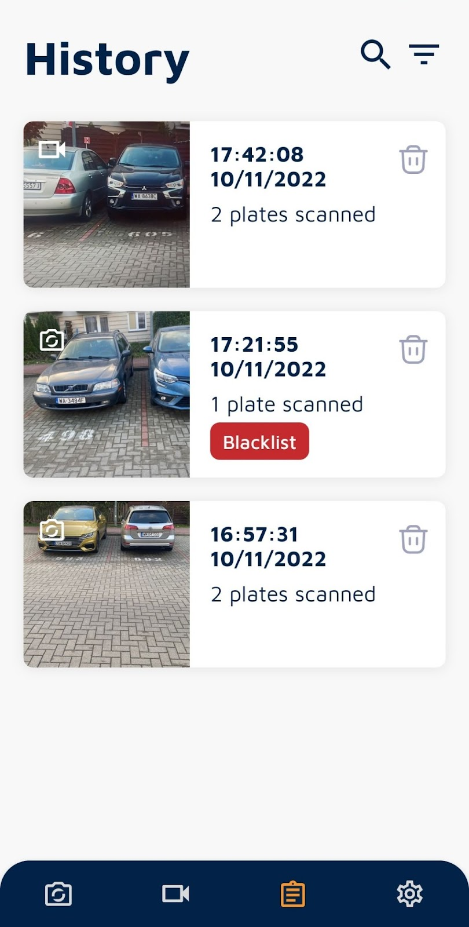
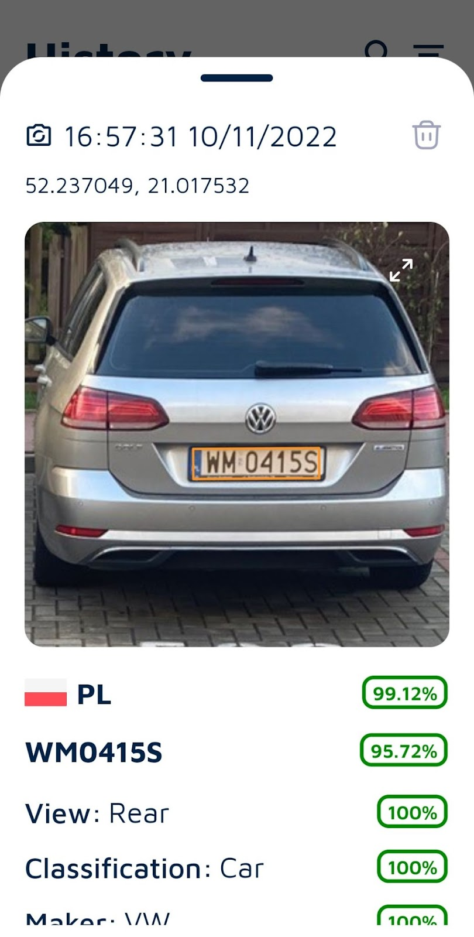
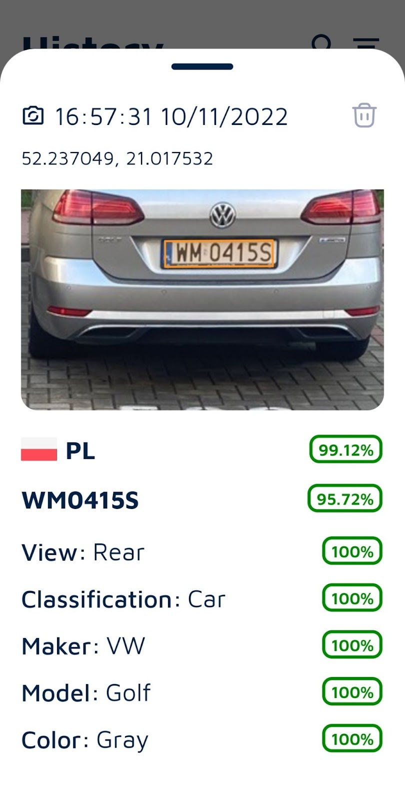
QCAM-App
Example

Slide 12
QCAM-App
Back office for storage control

Slide 13
QCAM-App
Keypoints
No permanent internet needed (underground parking, tunnels, no network coverage)
ANPR + MMR + colour information
Linked to M³
1 M³ can collect all data from connected phones
Can also be used to record all vehicles from an event
Standard police-controls are much faster
Conclusion
Must have application to make the make all police-activities easier
All together for a safer place

Slide 14
Section Control

Slide 15
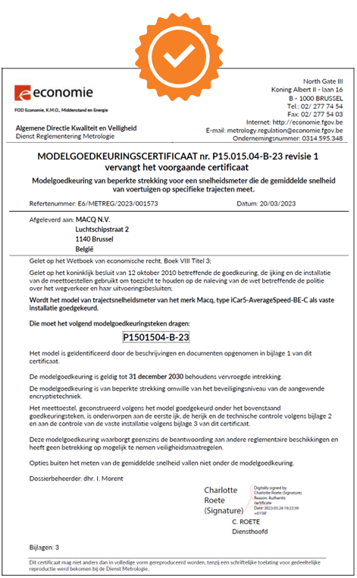
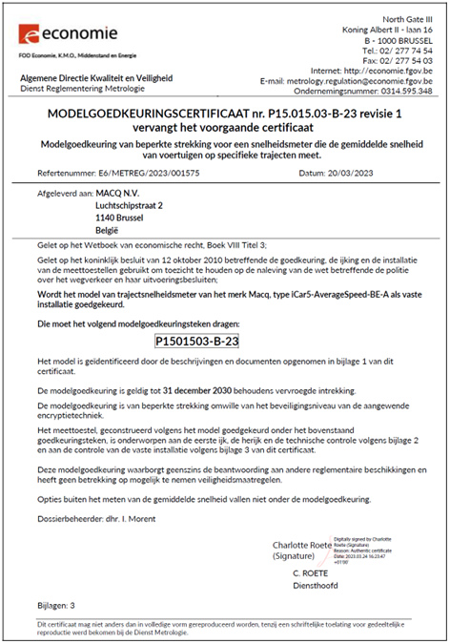
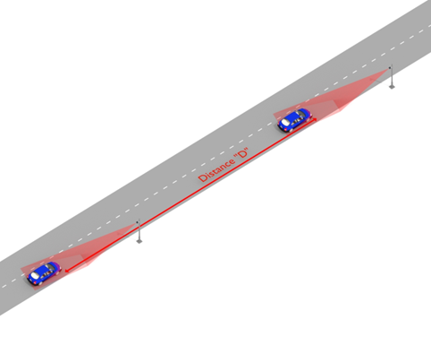
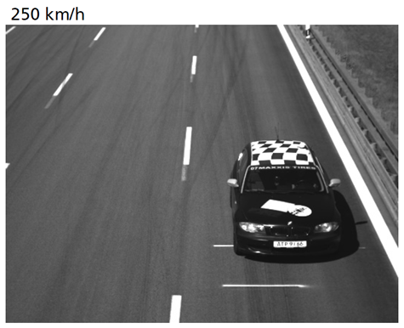
Section Control
Homologated

Slide 16
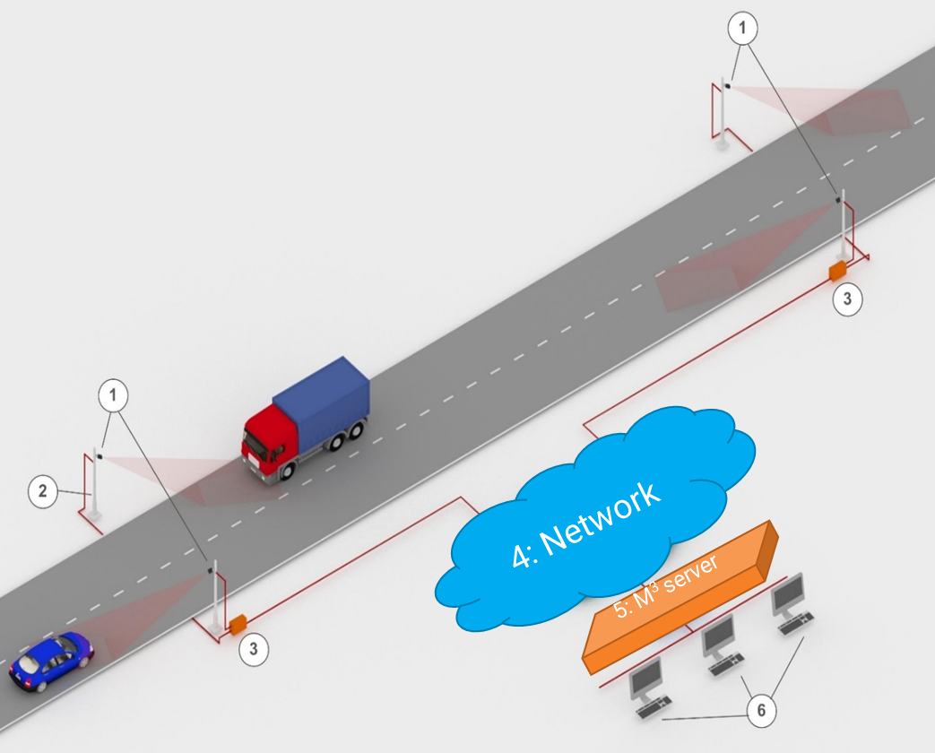
Section Control
Typical

Slide 17
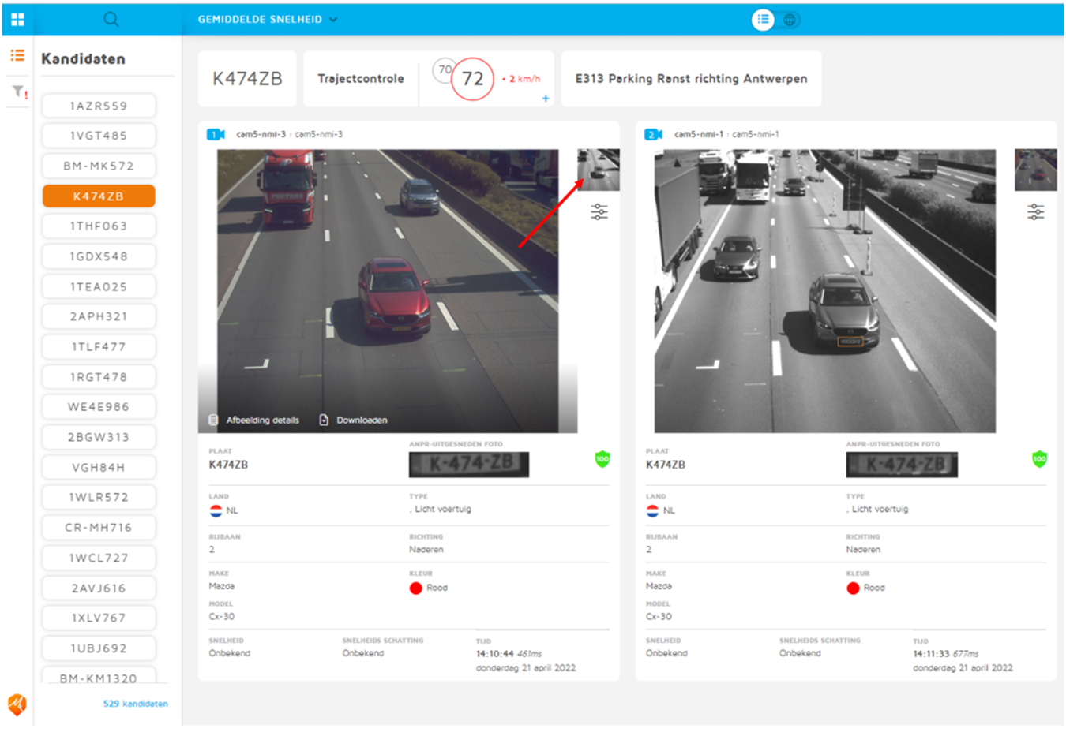
Section Control
Back office

Slide 18
QCAM-App
Keypoints
Homologated in Belgium, Lithuania,…
Short traject available : 200 m
1 back-office in a secure data-center for all your sites
2 lanes/camera
Manage several configurations (entry, exits,…)
Secured!
Can be combined with blacklist, ANPR, mobility analysis, …
Conclusion
Rolls Royce of the average speed possibilities

Slide 19
Thank you!
Visit our website www.macq.eu

