Slide 1
We welcome a new generation of dashboards: Revolutionizing Traffic Management!

Slide 2
1. Introduction to the Mobility Dashboards
2. Dashboards
3. Key features of the Mobility Dashboards

Slide 3
Introduction to the Mobility Dashboards

Slide 4
Introduction to the Mobility Dashboards
Project Context: Part of the Torres research project funded by The Region of Brussels-Capital (Innoviris).
Development: Macq has developed a proof-of-concept Mobility dashboard.
Data Source: Utilizes data from Macq ANPR Cameras in the city’s Low Emission Zone.
Dashboard Functionality:
Interactive and user-friendly interface.
Extracts insights from complex traffic data.
Purpose:
Helps mobility stakeholders understand traffic patterns and issues.
Guides decision-making towards more effective mobility solutions.

Slide 5
Dashboards

Slide 6
Dashboards 1
This first dashboard helps identify patterns requiring more attention.
Then, thanks to easy to use filters, you can focus your attention to this specific time range and understand how the event occurs in space.

Slide 7
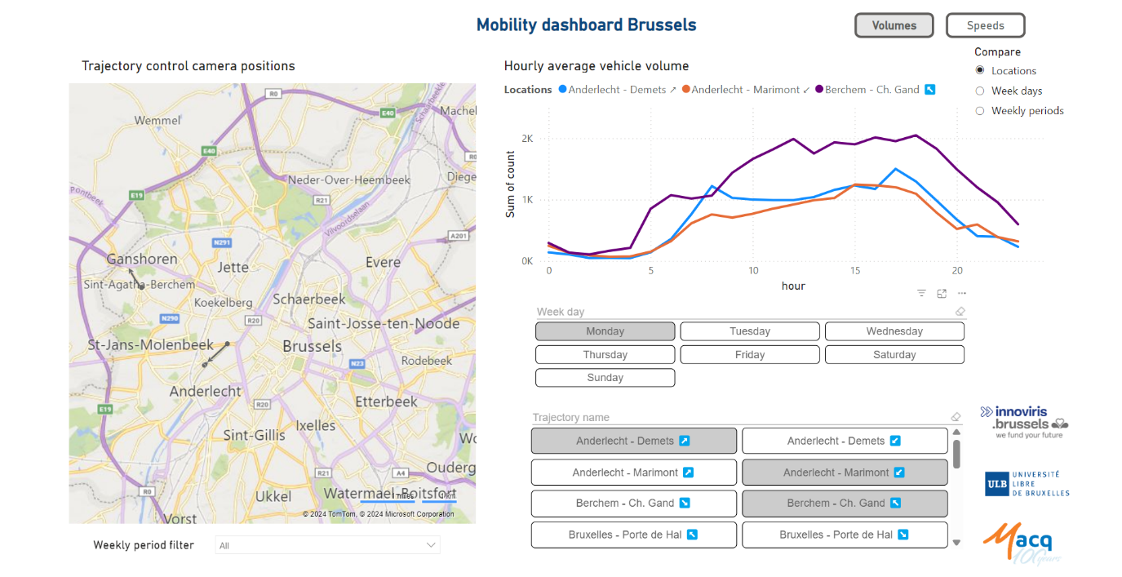
Dashboards 2
Mobility Dashboard Brussels
Allows you to compare different situation.
For example, decide to compare traffic volumes between two locations, or two period of time.
Powerful tool to prioritize your mobility problems

Slide 8
Key Freatures of the Mobility Dashboards

Slide 9
Key Features
Pattern Identification: Pinpoints areas needing attention such as overspeeding, traffic volume, and type.
Time Analysis: Analyzes when specific traffic behaviors are most prevalent.
Interactive Filters: Allows for focused investigation within specific time ranges.
Spatial Insight: Understands how events unfold geographically.
Outcome: Enables planning of effective measures to enhance urban mobility and citizen well-being.

Slide 10
Thank you!
Visit our website www.macq.eu

